Slide 1
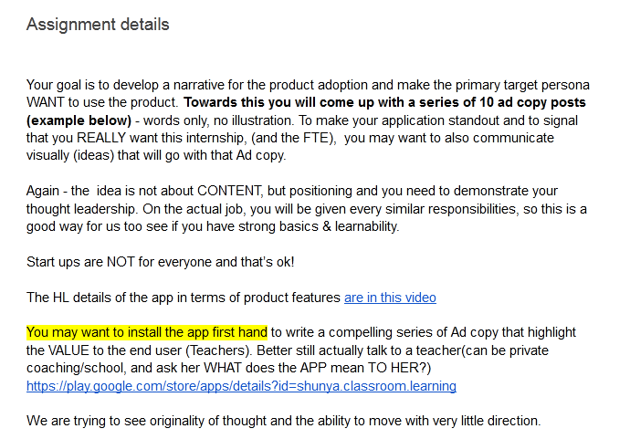

Slide 2
Shunya Intelligent Classroom

Slide 3

Name : Mona
Age : 25
Occupation : Teacher
Status : Not married
Location : Bangalore
Goals:
To teach student is the main motive
She have to help students to increase their knowledge.
Frustration:
School assignments are doing more trouble for her.
She is not able to grade each and every student.
User Scenario:
Mona is a teacher. She is working in a school. She is a mentor for nearly 200 students. She is helping those students to increase their score. So she planned to conduct assignments in weekly basis. In the first week, she corrected assignments of all students. On the week, she was not able to correct all the student’s assignments.

Slide 4
Contents
https://play.google.com › store › apps › details › id=shu...
Shunya – Make assignment easy to autograde
16-Nov-2022 — Features in current app to Manage your entire classroom - Notes, assignments, in app corrections of submissions. Easy & organised .
Videos

Slide 5
Attention
Easily assignment Done
Auto Grading
Submission history
Notes:
Consider talking about:
In practice

Slide 6
Interest
Multiple source option
More subject addons
Notes Inclusion

Slide 7
Desire
Easy uploadation
Easy file upload in App.
Camera option available

Slide 8
Actions
Self study kit
Extra curricular Activities
Student E-Learning

